Slide 1





Data Definition and Data Types
Managing DBs using IDEs
Databases
Basics
SoftUni Team
Technical Trainers
SQL
Software University
http://softuni.bg

Slide 2

Table of Contents
Common data types
Creating a database using MySQL / MSSQL
Creating a table using MySQL / MSSQL
Dropping table using MySQL / MSSQL
Altering a table using MySQL / MSSQL
Filling a table using MySQL / MSSQL
Truncating a table using MySQL / MSSQL

Slide 3
Questions
sli.do #5604

Slide 4
Common Data Types
Data type | SQL Server | MySQL
Boolean | BIT | TINYINT
Integer | INT | INT
Floating-point | FLOAT | FLOAT, Double
String(fixed) | CHAR(n) NCHAR(n) | CHAR(n)
String (variable) | VARCHAR(n) NVARCHAR(n) | VARCHAR(n)
Binary Object | BINARY(n) (fixed up to 8K) VARBINARY(n) (<8K) VARBINARY(max) (>8K & < 2G) | BINARY(n) VARBINARY(n)
Date | DATE DATETIME | DATE DATETIME
Notes:
bit (Transact-SQL)
An integer data type that can take a value of 1, 0, or NULL.
The SQL Server Database Engine optimizes storage of bit columns. If there are 8 or less bit columns in a table, the columns are stored as 1 byte. If there are from 9 up to 16 bit columns, the columns are stored as 2 bytes, and so on.
The string values TRUE and FALSE can be converted to bit values: TRUE is converted to 1 and FALSE is converted to 0.
MySQL: you can use bool and boolean which are at the moment aliases of tinyint(1). A value of zero is considered false. Non-zero values are considered true.
MSSQL: char is with fixed size and cannot store Unicode symbols. If the length of the entered sequence is less.
MSSQL: varchar is with flexible size but similar to char on all other criteria.
MSSQL char/varchar – additional info https://msdn.microsoft.com/en-us/library/ms176089.aspx
MSSQL nchar/nvarchar – almost identical to char/varchar but with the difference that you can put Unicode symbols and therefor each one of them take more space.
MySQL: char is very similar to the char of MSSQL, but it can hold Unicode symbols. If the entered value is shorter than the size of the char(n), the rest is filled with spaces which are truncated when retrieved. The entered value is trimmed from trailing spaces, so ‘aa ’ results in ‘aa’ when retrieved.
MySQL: varchar is very similar to the nvarchar of MSSQL. It does not trim trailing white spaces of a value.
MySQL: char/varchar – additional info http://dev.mysql.com/doc/refman/5.7/en/char.html
MSSQL: binary/varbinary – analog of char/varchar, but for saving data as plain bytes
MSSQL: binary/varbinary – additional info https://msdn.microsoft.com/en-us/library/ms188362.aspx
MySQL: binary/varbinary - analog of the char/varchar, but for saving data as bytes
MYSQL: binary/varbinary – additional info http://dev.mysql.com/doc/refman/5.7/en/binary-varbinary.html
MYSQL: blob – differs very slightly from varbinary by the following things: There is no trailing-space removal for BLOB when values are stored or retrieved. BLOB columns cannot have DEFAULT values.

Slide 5

Creating Database

Slide 6
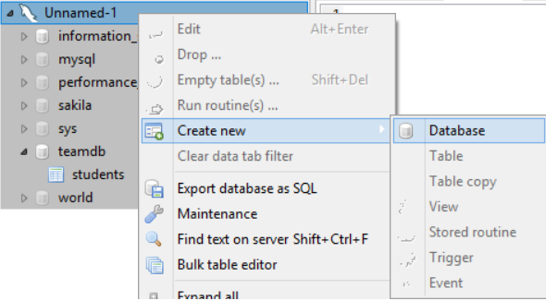
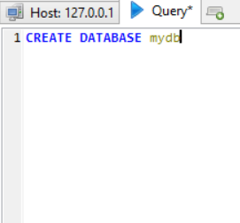
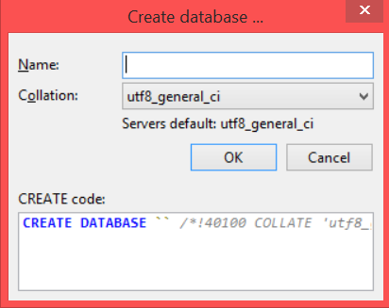
MySQL
Using HeidiSQL

Slide 7
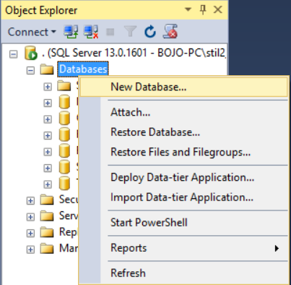
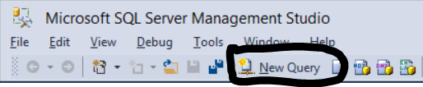
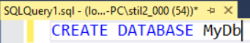
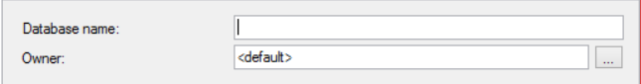
SQL Server
Using SSMS

Slide 8

Creating Tables

Slide 9
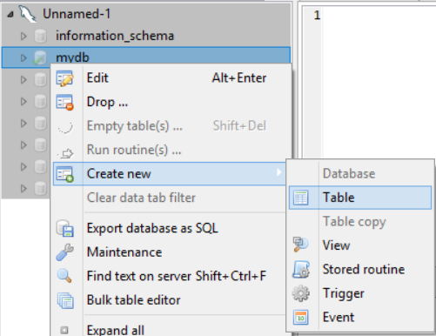
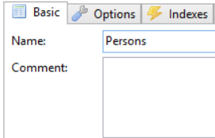
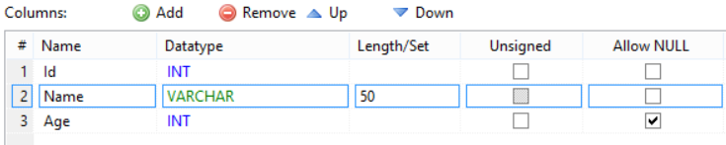
MySQL
Using HeidiSQL
CREATE TABLE table_name
(
id INT NOT NULL,
name VARCHAR(50) NOT NULL,
age INT
)

Slide 10
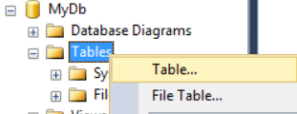
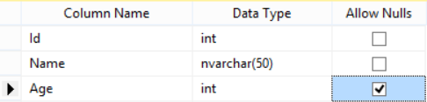
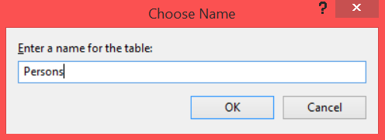
SQL Server
Using SSMS
CREATE TABLE TableName
(
Id INT NOT NULL,
Name VARCHAR(50) NOT NULL,
Age INT
)
Ctrl + S

Slide 11

Adding primary key constraints

Slide 12
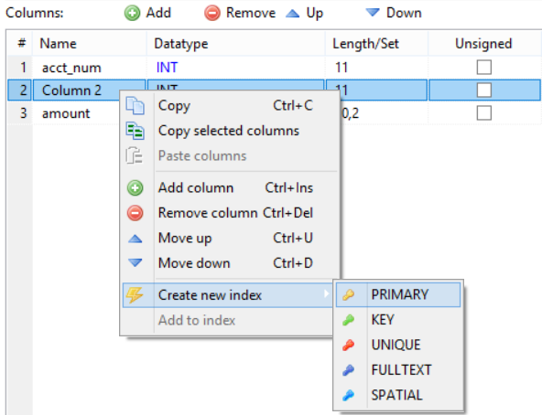
MySQL
Using HeidiSQL
CREATE TABLE table_name ( P_Id int NOT NULL, PRIMARY KEY (P_Id) )

Slide 13
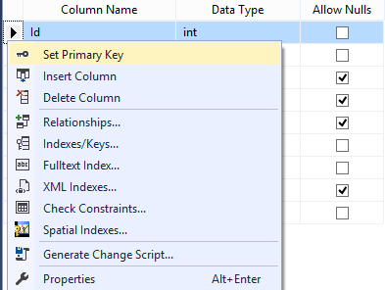
SQL Server
Using SSMS
Right click the wanted column
CREATE TABLE TableName ( P_Id int NOT NULL PRIMARY KEY )

Slide 14
Adding auto increment
MySQL
SQL Server
CREATE TABLE Persons ( ID int NOT NULL AUTO_INCREMENT, )
CREATE TABLE Persons ( ID int IDENTITY PRIMARY KEY )

Slide 15
Adding check constraint
MySQL
SQL Server
CREATE TABLE table_name ( P_Id INT, CHECK (P_Id>0) )
CREATE TABLE TableName ( P_Id INT CHECK (P_Id>0) )

Slide 16
MySQL
Adding default value
SQL Server
CREATE TABLE table_name ( City varchar(255) DEFAULT 'Sandnes' )
CREATE TABLE TableName ( City varchar(255) DEFAULT 'Sandnes' )

Slide 17
Set unique field
MySQL
SQL Server
CREATE TABLE table_name ( P_Id INT, UNIQUE (P_Id) )
CREATE TABLE TableName ( P_Id INT UNIQUE )

Slide 18

Dropping Table

Slide 19
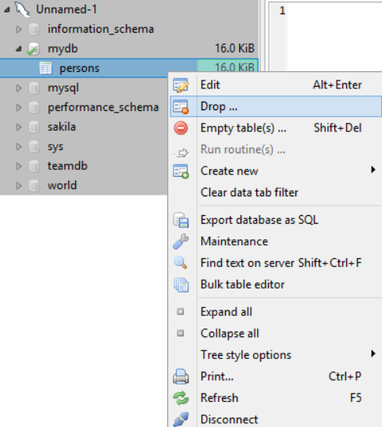
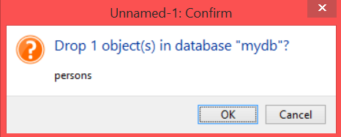
MySQL
Using HeidiSQL
DROP TABLE table_name

Slide 20
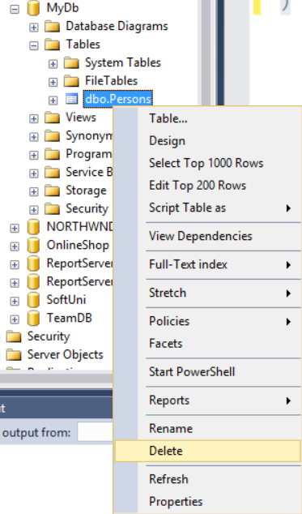
SQL Server
Using SSMS
DROP TABLE TableName

Slide 21
Dropping primary keys

Slide 22
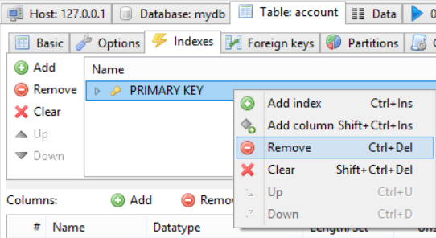
MySQL
Using HeidiSQL
ALTER TABLE table_name DROP PRIMARY KEY

Slide 23
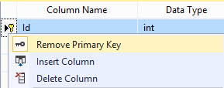
SQL Server
Using SSMS
Right click the wanted column
ALTER TABLE TableName DROP CONSTRAINT ConstraintName

Slide 24
Dropping check constraint
MySQL
SQL Server
ALTER TABLE table_name DROP CHECK check_name
ALTER TABLE TableName DROP CONSTRAINT check_name

Slide 25
MySQL
Dropping default value
SQL Server
ALTER TABLE table_name ALTER column_name DROP DEFAULT
ALTER TABLE TableName ALTER COLUMN ColumnName DROP DEFAULT

Slide 26
Drop unique field
MySQL
SQL Server
ALTER TABLE table_name DROP INDEX constraint_name
ALTER TABLE TableName DROP CONSTRAINT ConstraintName

Slide 27

Dropping Database

Slide 28
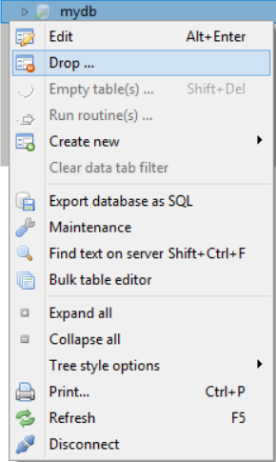
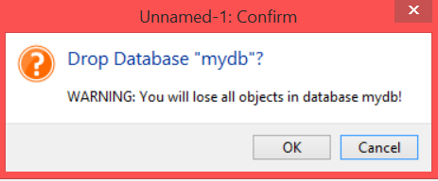
MySQL
Using HeidiSQL
DROP DATABASE database_name

Slide 29
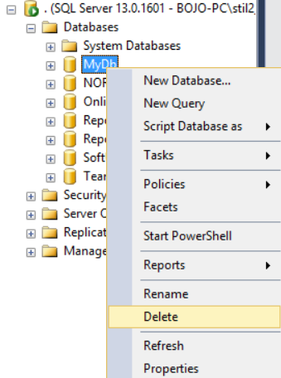
SQL Server
Using SSMS
DROP DATABASE DatabaseName

Slide 30

Altering Tables and Columns

Slide 31
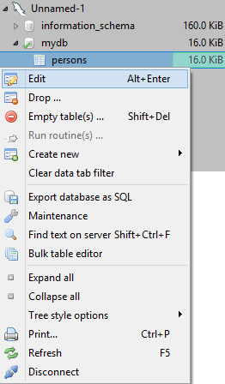
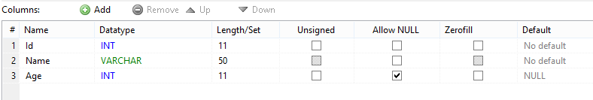
MySQL
Using HeidiSQL
Add column:
ALTER TABLE table_name ADD column_name VARCHAR(50)
Delete column:
ALTER TABLE table_name
DROP COLUMN column_name
Modify type of column:
ALTER TABLE table_name MODIFY COLUMN column_name datatype

Slide 32
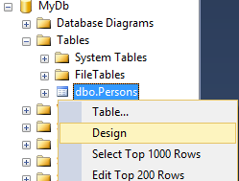
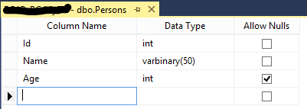
SQL Server
Using SSMS
Add column:
ALTER TABLE TableName ADD ColumnName VARCHAR(50)
Delete column:
ALTER TABLE TableName
DROP COLUMN ColumnName
Modify type of column:
ALTER TABLE TableName ALTER COLUMN ColumnName datatype

Slide 33
Altering table and adding primary keys

Slide 34
MySQL/SQL Server
ALTER TABLE table_name ADD PRIMARY KEY (column(s))
ALTER TABLE table_name ADD CONSTRAINT constrant_name PRIMARY KEY (column(s))

Slide 35
Adding check constraint on altering table
MySQL/SQL Server
ALTER TABLE Persons ADD CHECK (check condition)
ALTER TABLE Persons ADD CONSTRAINT check_name CHECK (check condition)

Slide 36
MySQL
Adding default value on alter table
SQL Server
ALTER TABLE table_name ALTER column_name SET DEFAULT default_value
ALTER TABLE TableName ALTER COLUMN ColumnName SET DEFAULT DefaultValue

Slide 37
Adding unique field on alter table
MySQL/SQL Server
ALTER TABLE TableName ADD UNIQUE (column(s))
ALTER TABLE TableName ADD CONSTRAINT unique_constraint_name UNIQUE (column(s))

Slide 38

Inserting and Selecting Data

Slide 39
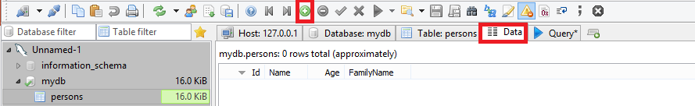
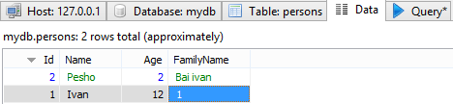
Using HeidiSQL
Click the plus and enter data

Slide 40
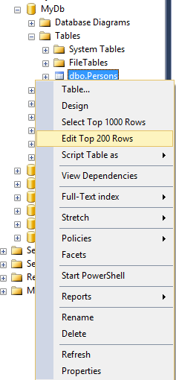
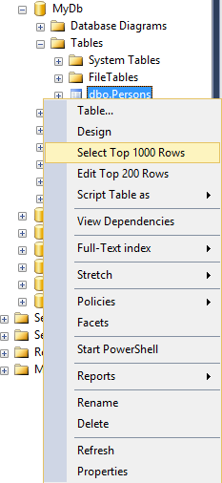
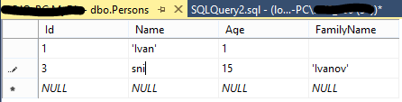
Using SSMS

Slide 41

Truncating Data

Slide 42
Erasing Data
TRUNCATE TABLE People

Slide 43


Summary
We can create and modify or delete databases or tables using the SQL language version in either SQL Server and MySQL.
We can easily fill data into our database using the IDE for the corresponding technology and later, see the data from the tables.

Slide 44









Data Definition and Data Types
https://softuni.bg/courses/databases

Slide 45
License
This course (slides, examples, demos, videos, homework, etc.) is licensed under the "Creative Commons Attribution-NonCommercial-ShareAlike 4.0 International" license
Attribution: this work may contain portions from
"Databases" course by Telerik Academy under CC-BY-NC-SA license

Slide 46





Free Trainings @ Software University
Software University Foundation – softuni.org
Software University – High-Quality Education, Profession and Job for Software Developers
softuni.bg
Software University @ Facebook
facebook.com/SoftwareUniversity
Software University @ YouTube
youtube.com/SoftwareUniversity
Software University Forums – forum.softuni.bg

